Slide 1
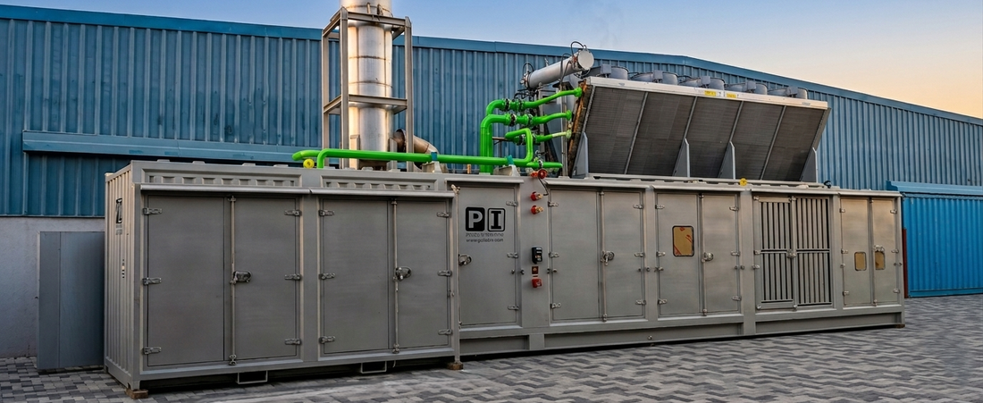
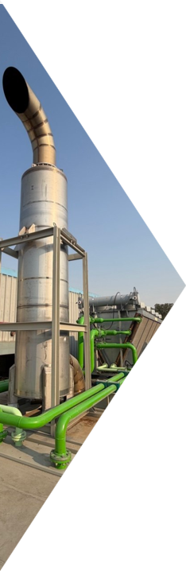
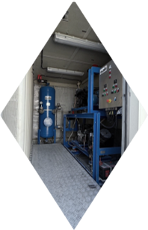
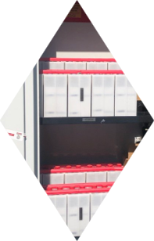

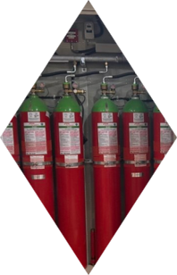
2500 kVA Medium Voltage Diesel Generator for Critical Oil & Gas Operations
In critical oil & gas facilities, power failure is not an option. Precision Industries (PI) engineered and manufactured a fully integrated 2500 kVA Medium Voltage diesel generator system designed to deliver reliable standby power, advanced safety protection, and black-start capability for hazardous operating environments.
Built specifically for demanding industrial applications, the system was engineered to ensure maximum reliability, operational safety, and performance under extreme conditions commonly found across the GCC region.
Engineered for Critical Reliability
The project required a highly reliable standby power solution capable of:
Operating safely in hazardous environments
Providing black-start capability during total power failure
Page 1

Slide 2
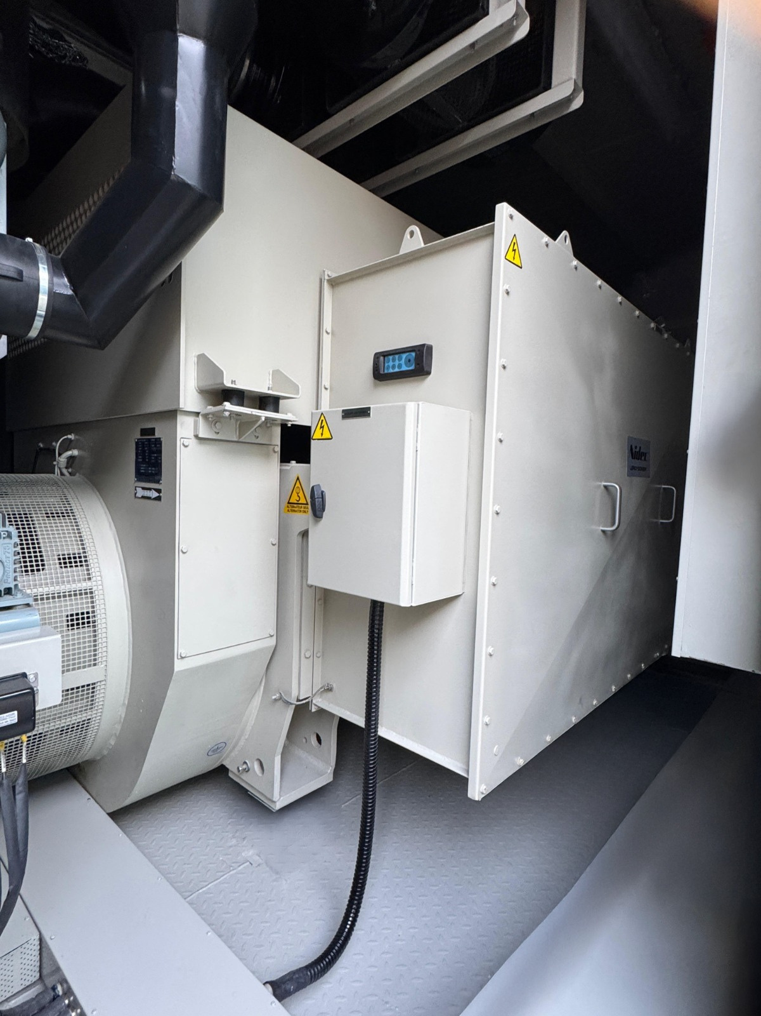
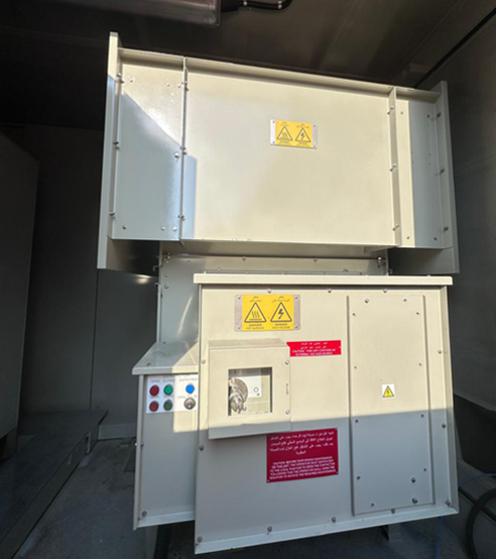
Integrating multiple safety and protection systems
Supporting Medium Voltage (3300V) operations
Reducing on-site installation complexity
To achieve this, Precision Industries designed and integrated the complete system in-house using advanced engineering, structural calculations, and 3D modelling techniques.
ENGINEERED FOR CRITICAL RELIABILITY
Advanced Control & Safety Systems
The generator system includes a fully customized control and protection architecture designed for critical oil & gas applications.
Key features include:
Page 2

Slide 3
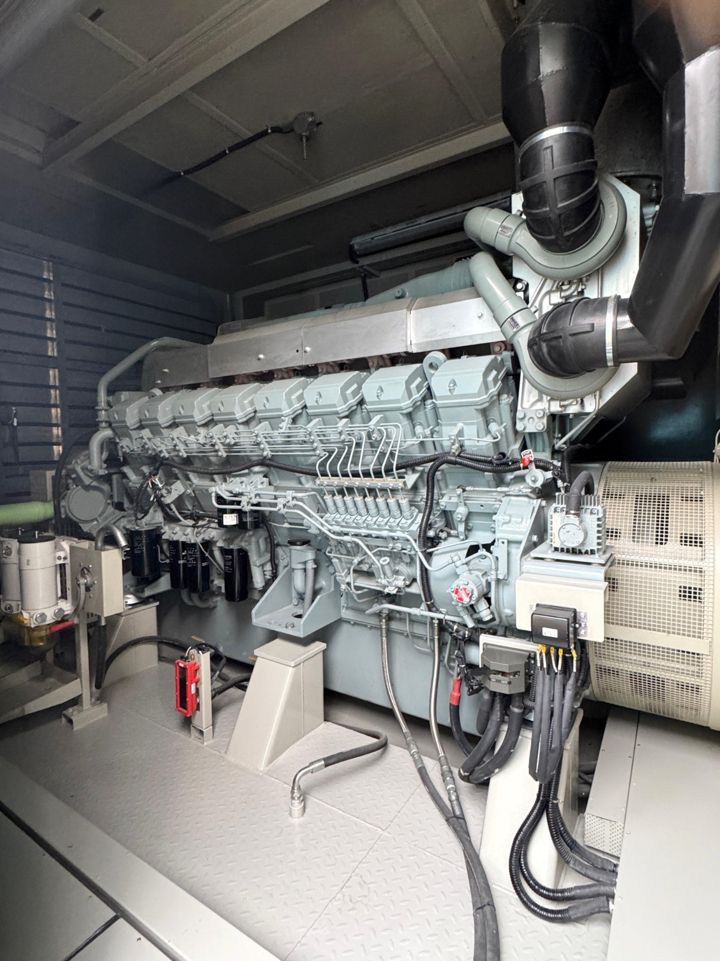
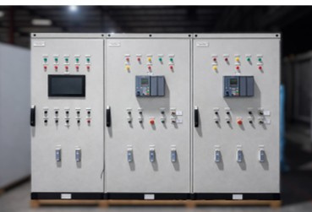
SIL-3 safety systems
Dual Ni-Cd battery and pneumatic starting systems
More than 20 reliable start attempts
Fully Automatic IG-541 Clean Agent Fire Suppression System
NFPA 2001 & NFPA 72 compliance
Neutral Grounding Resistor (NGR) assembly
Alternator high resistance grounding
Exhaust muffler with built-in spark arrestor
ADVANCED CONTROL & SAFETY SYSTEMS
All subsystems were fully integrated in-house by qualified engineers to ensure reliable operation and maximum safety.
Reliable Power for Demanding Environments
The delivered solution achieved:
Reliable standby power for critical operations
Enhanced safety in hazardous environments
Fully integrated system architecture
Proven performance under demanding industrial conditions
Page 3

Slide 4
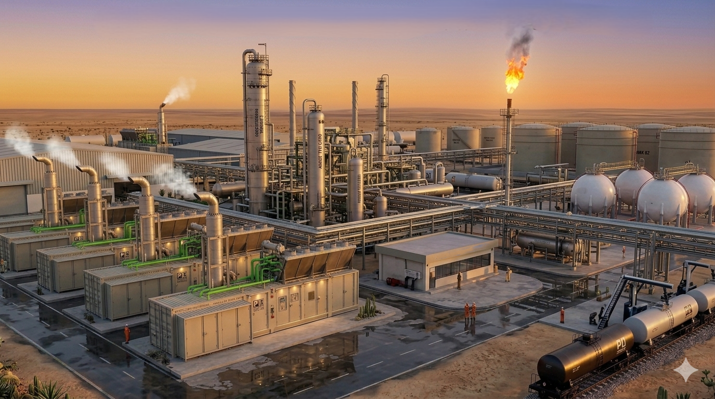
With more than 20 years of experience, Precision Industries continues delivering customized diesel generator and engineered power solutions for oil & gas, industrial, telecom, and critical infrastructure projects across the UAE, GCC, and Africa.
ADVANCED CONTROL & SAFETY SYSTEMS
Learn more about our power solutions:
www.pi-dubai.com
Precision Industries — Where POWER Meets PRECISION
Proudly Made in the UAE | فخورين بالإمارات
Page 4

